Slide 1
INFO-3142
Working with Text Data

Slide 2
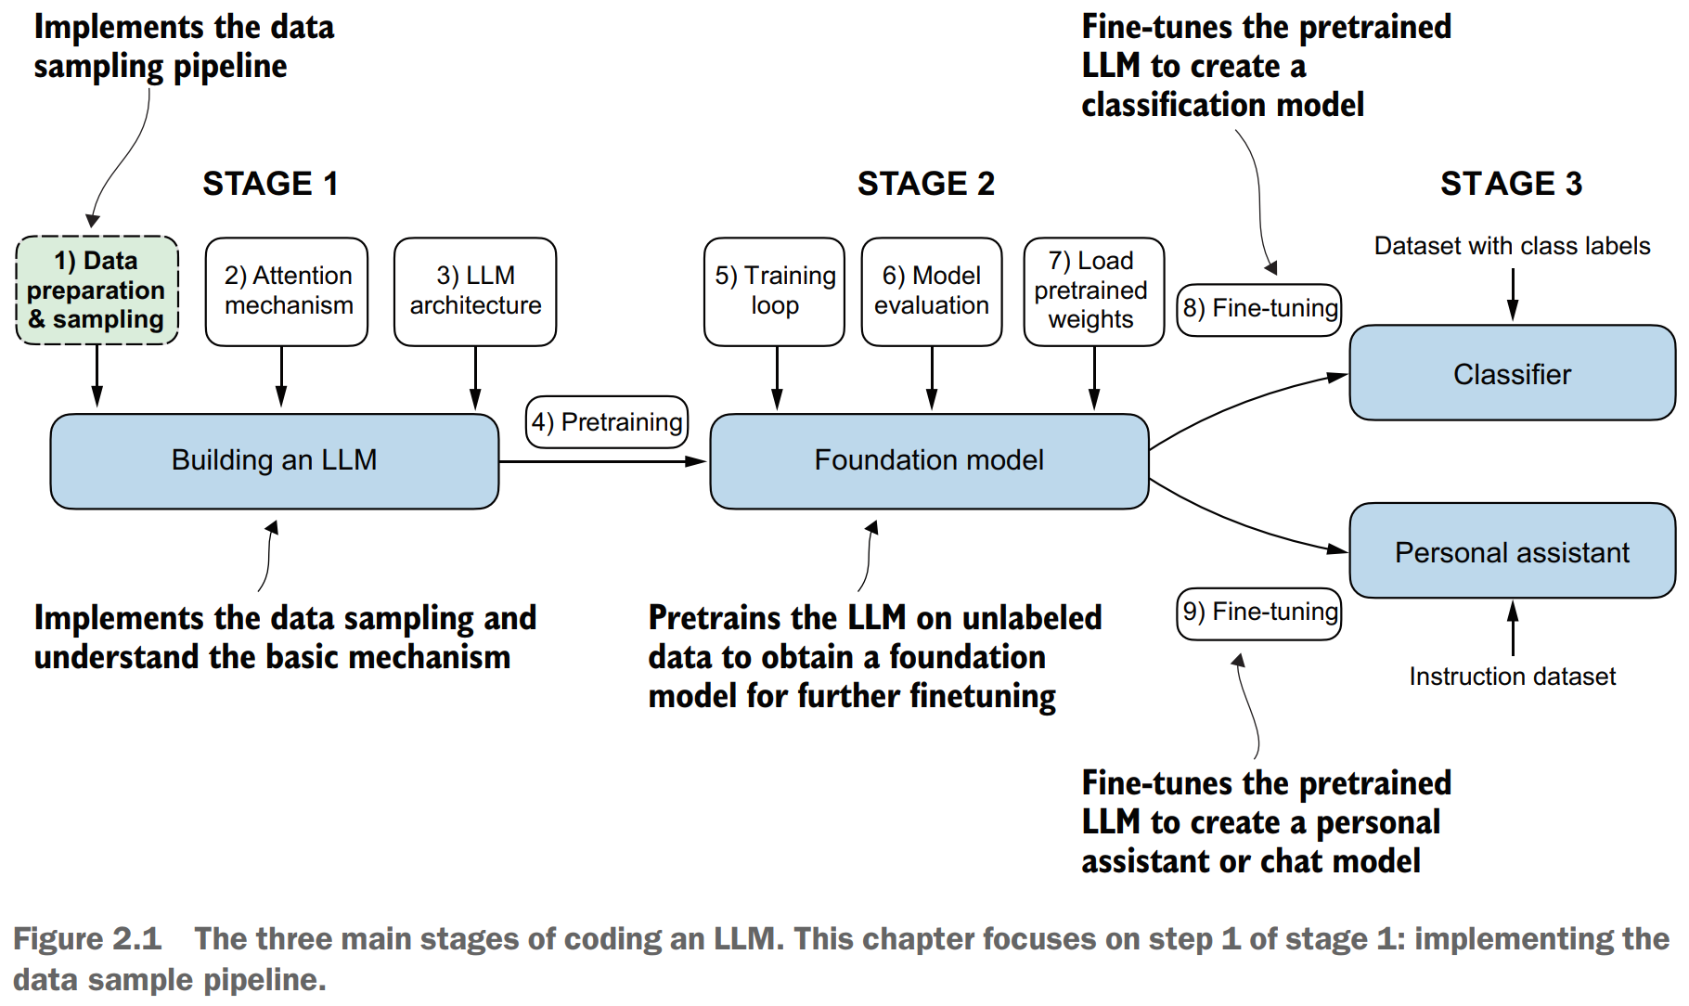
Main Stages of Coding an LLM

Slide 3
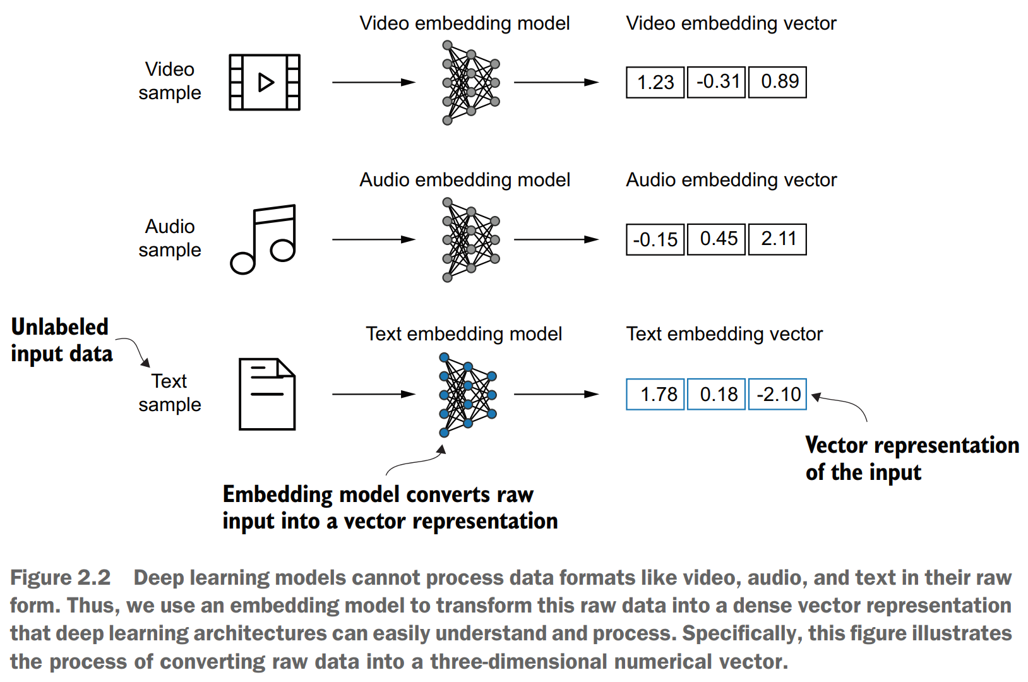
1. Word Embeddings

Slide 4
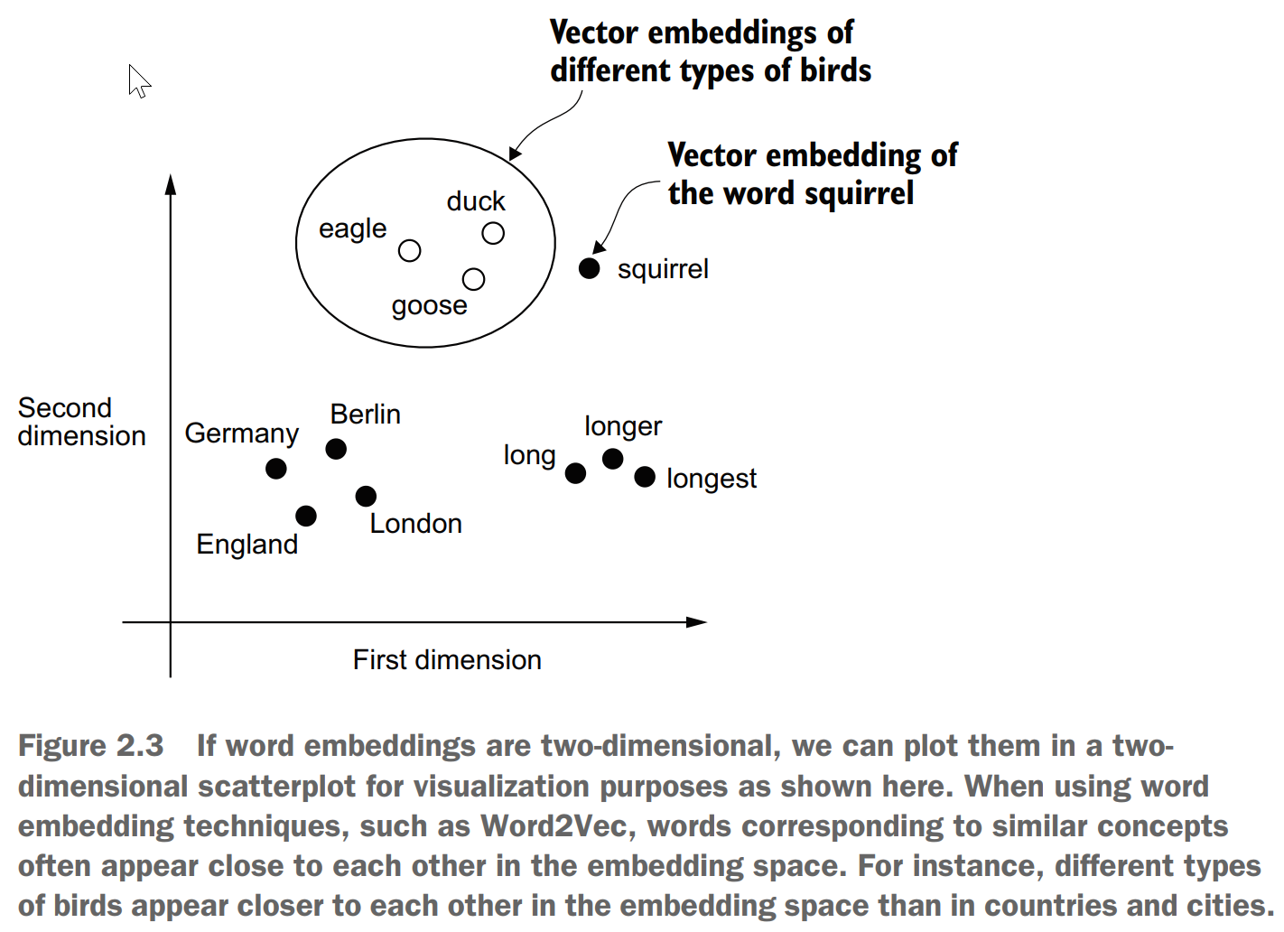
2. Word Embeddings

Slide 5
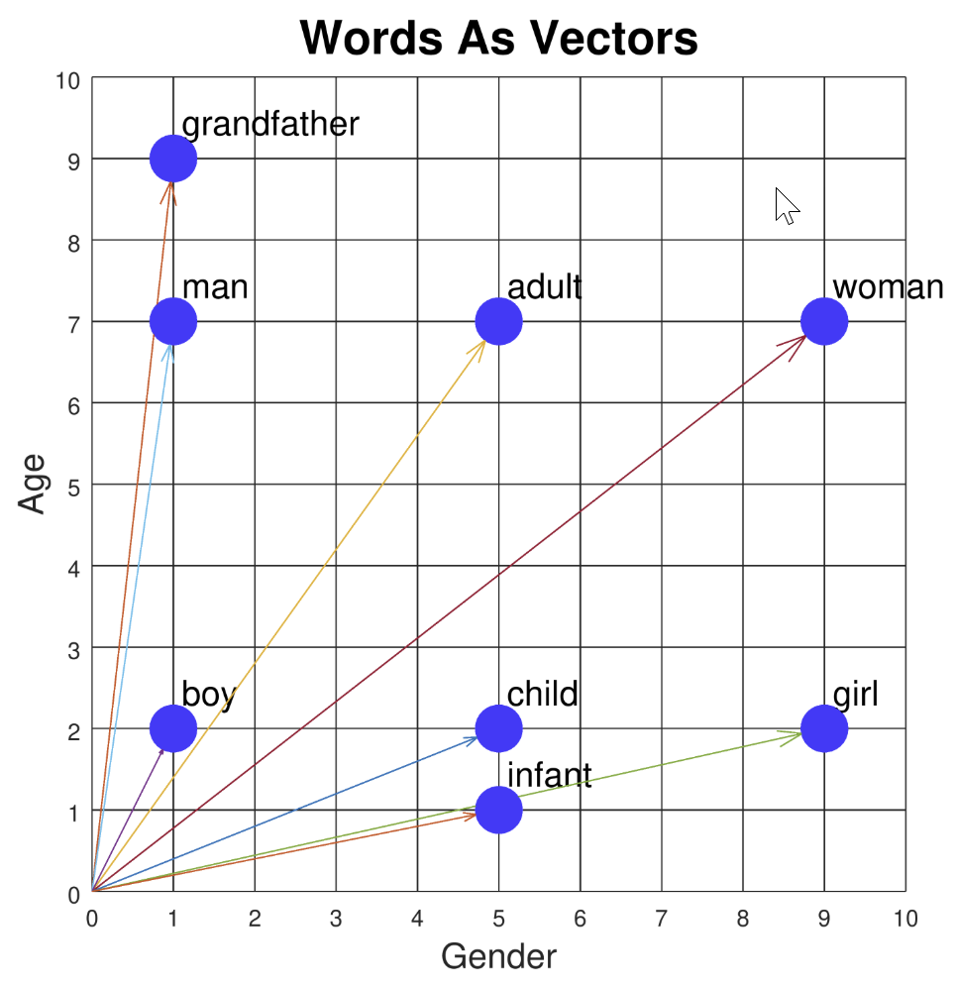
3. Word Embeddings

Slide 6
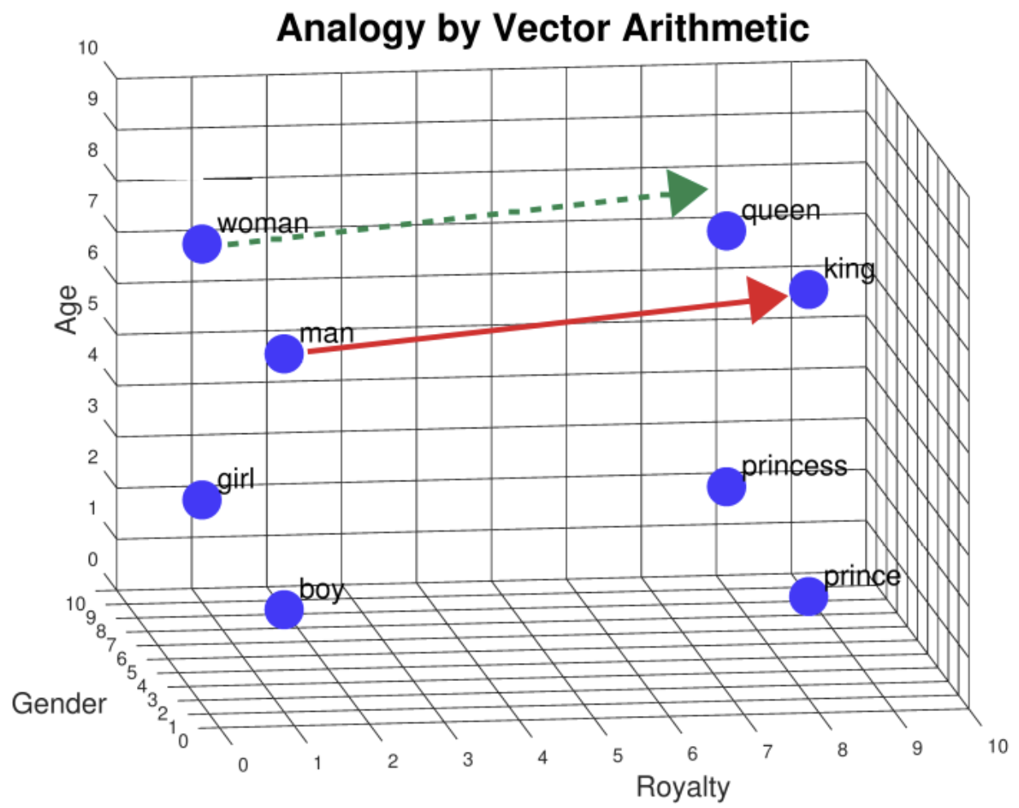
4. Word Embeddings

Slide 7
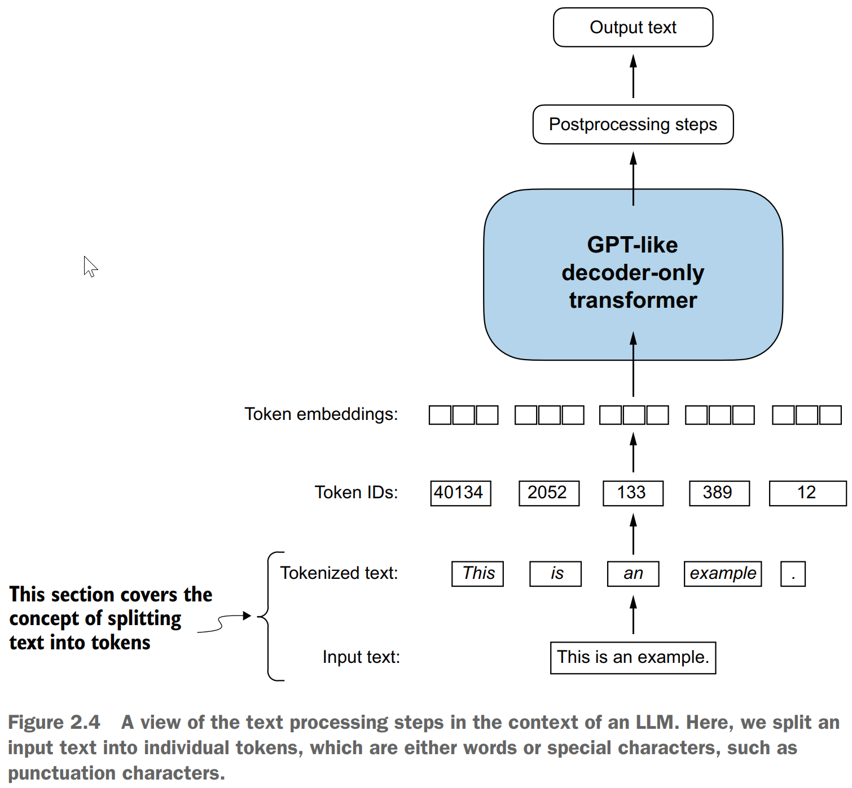
1. Tokenizing Text

Slide 8
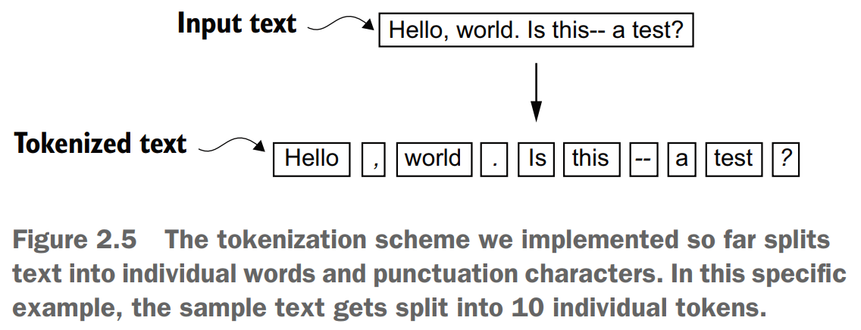
2. Tokenizing Text

Slide 9
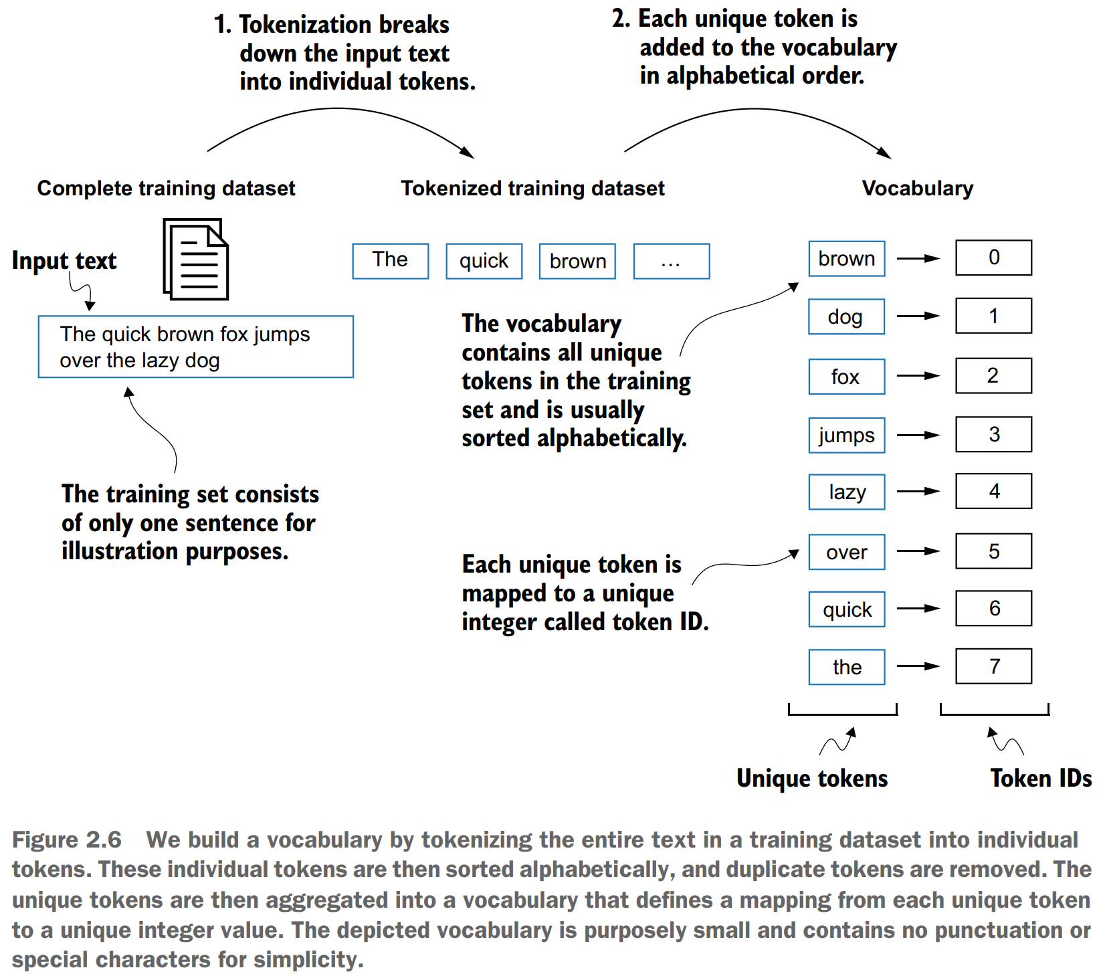
1. Converting Tokens into Token IDs

Slide 10
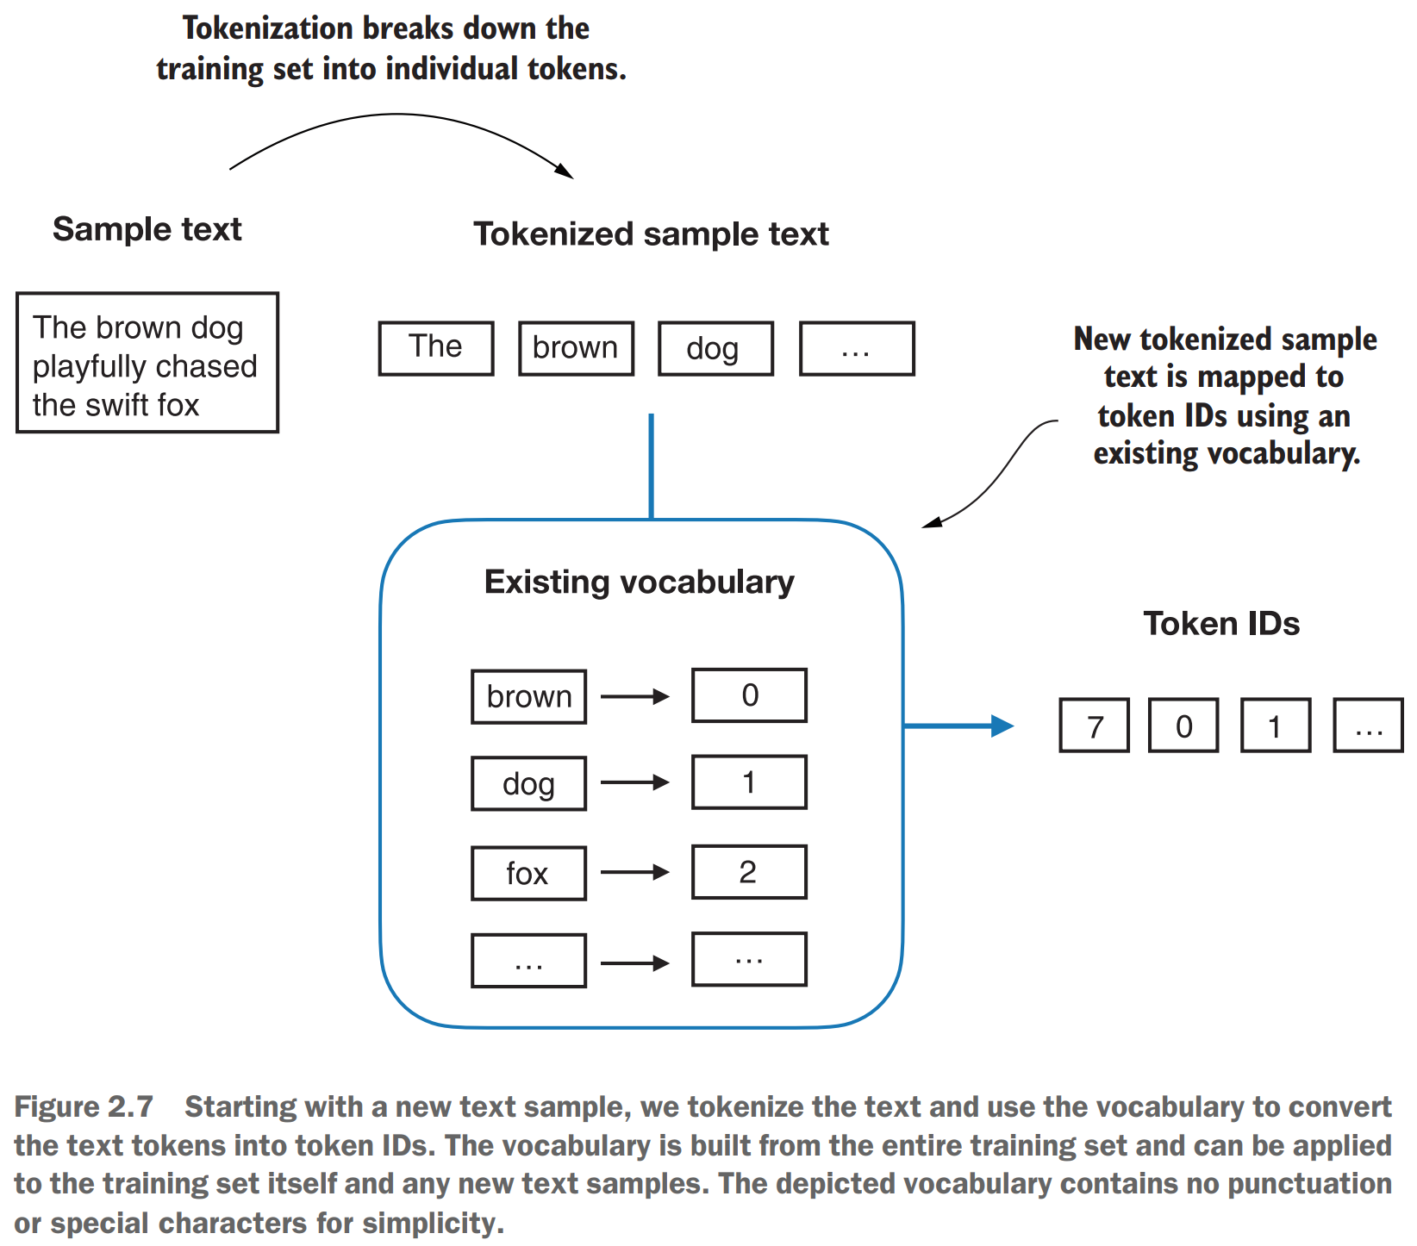
2. Converting Tokens into Token IDs

Slide 11
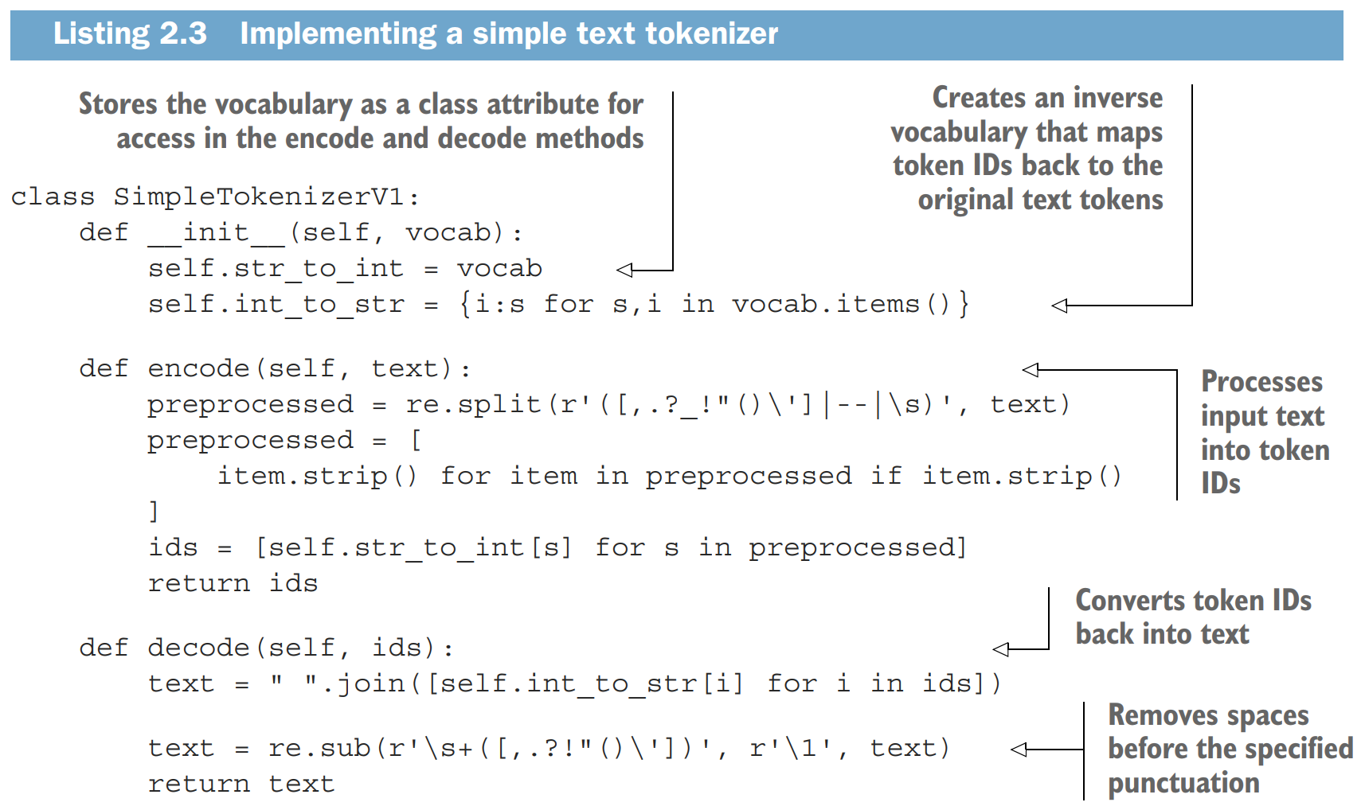
3. Converting Tokens into Token IDs

Slide 12
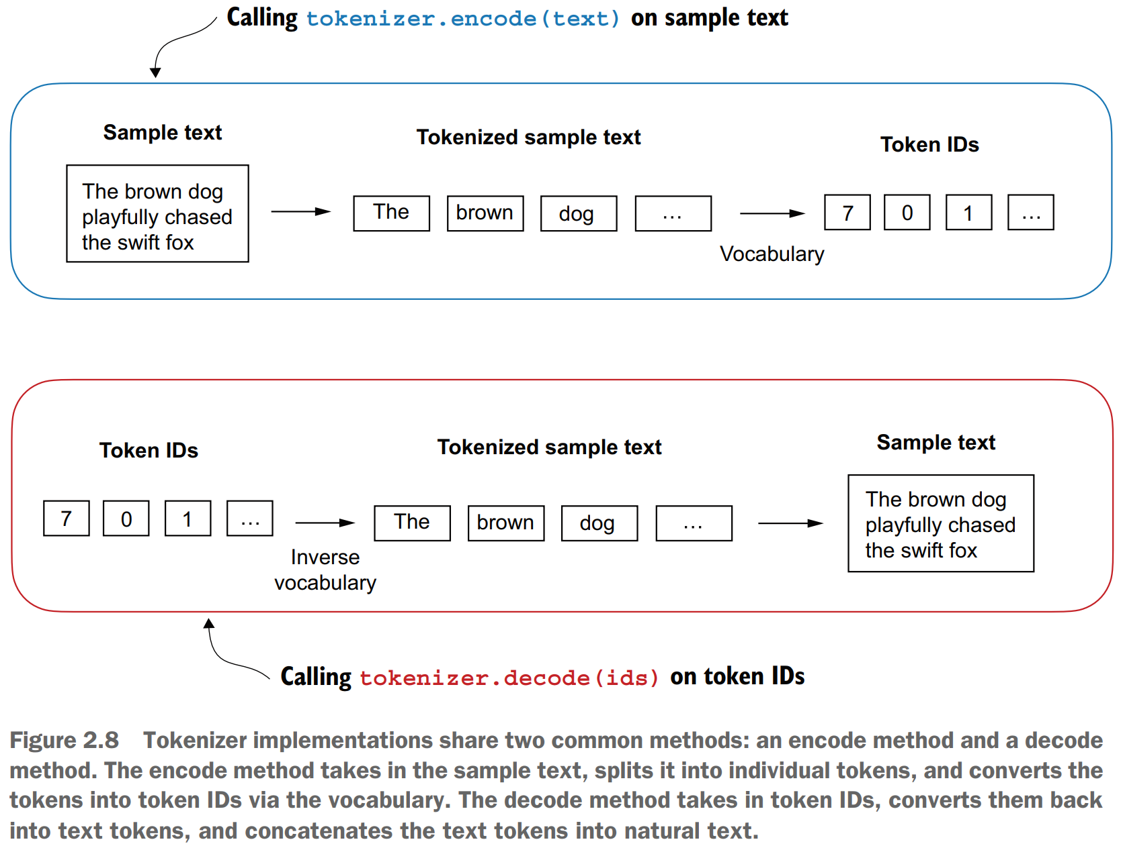
Tokenizer Encoding and Decoding

Slide 13
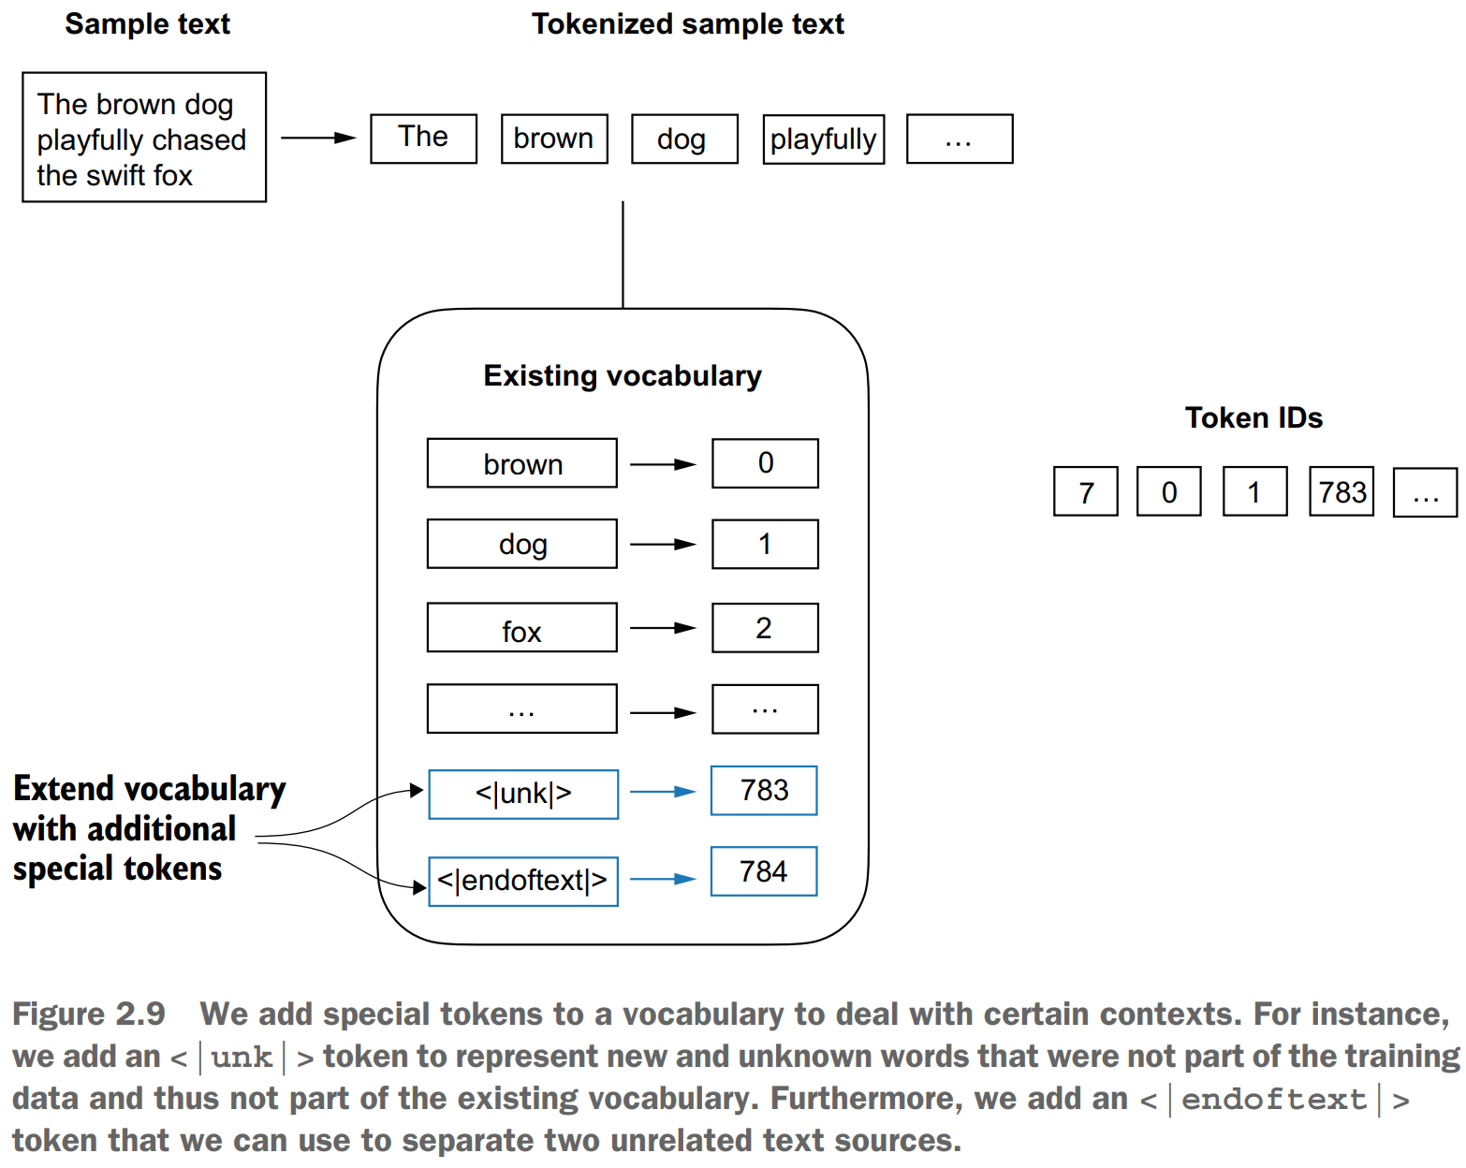
1. Adding Special Context Tokens

Slide 14
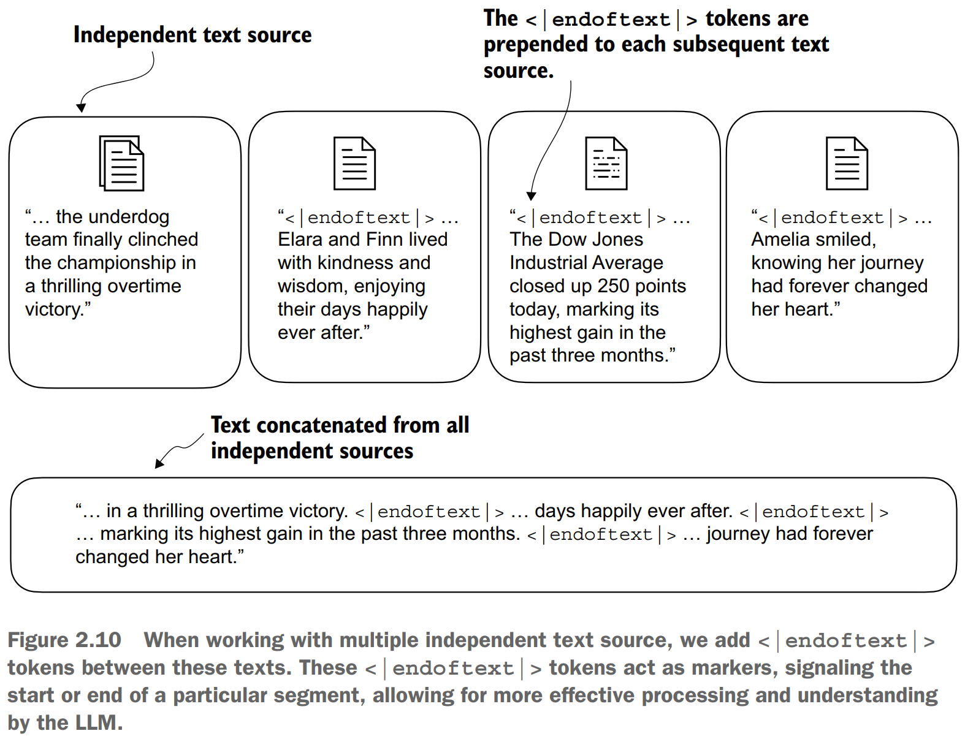
2. Adding Special Context Tokens

Slide 15
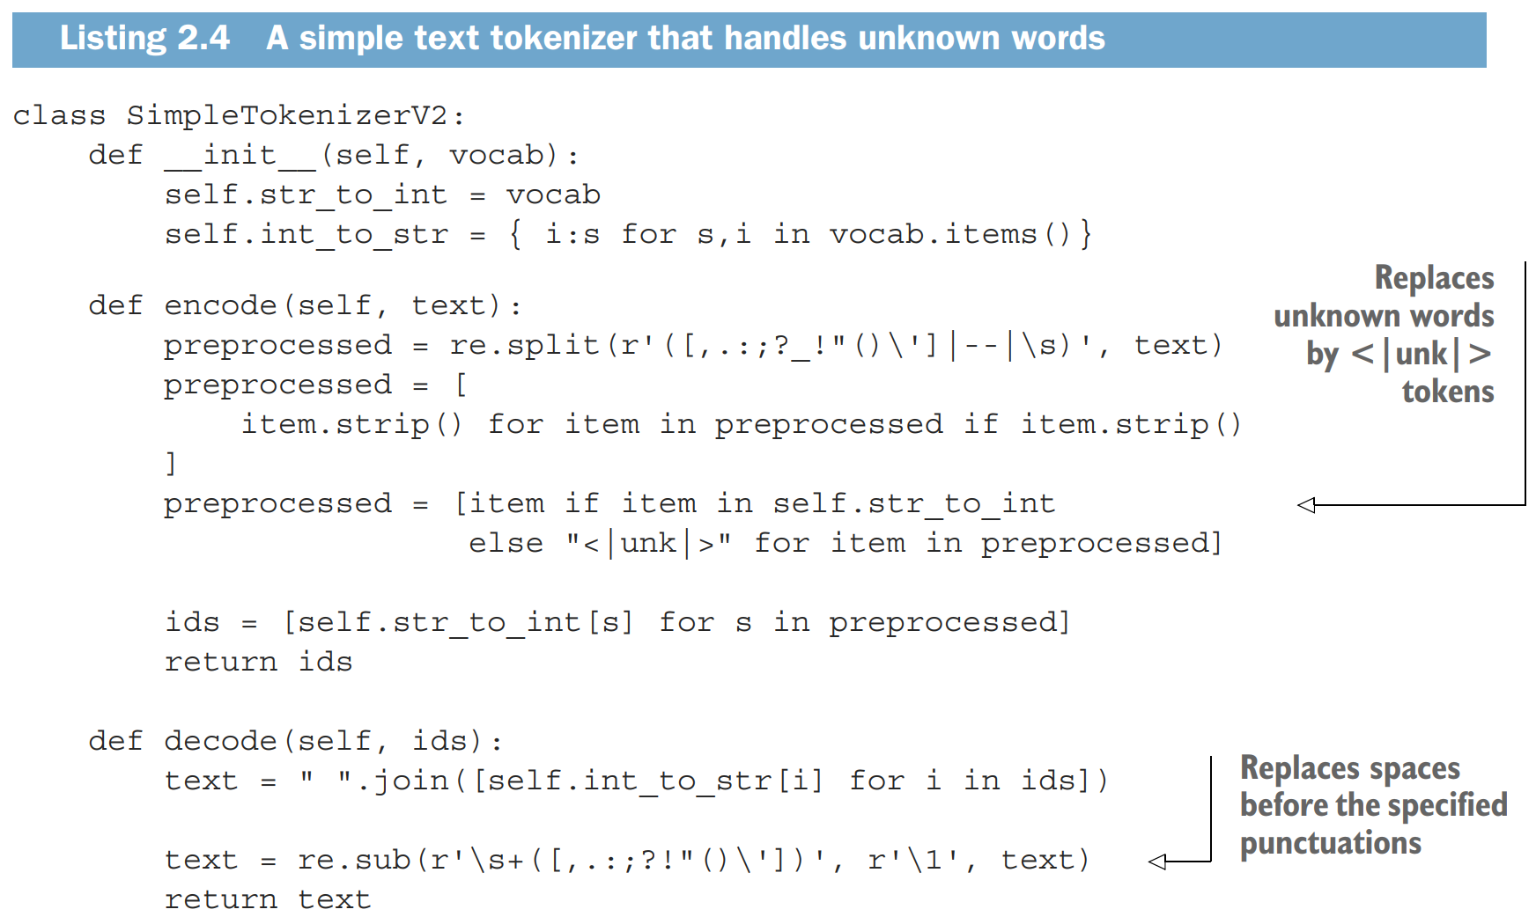
3. Adding Special Context Tokens

Slide 16
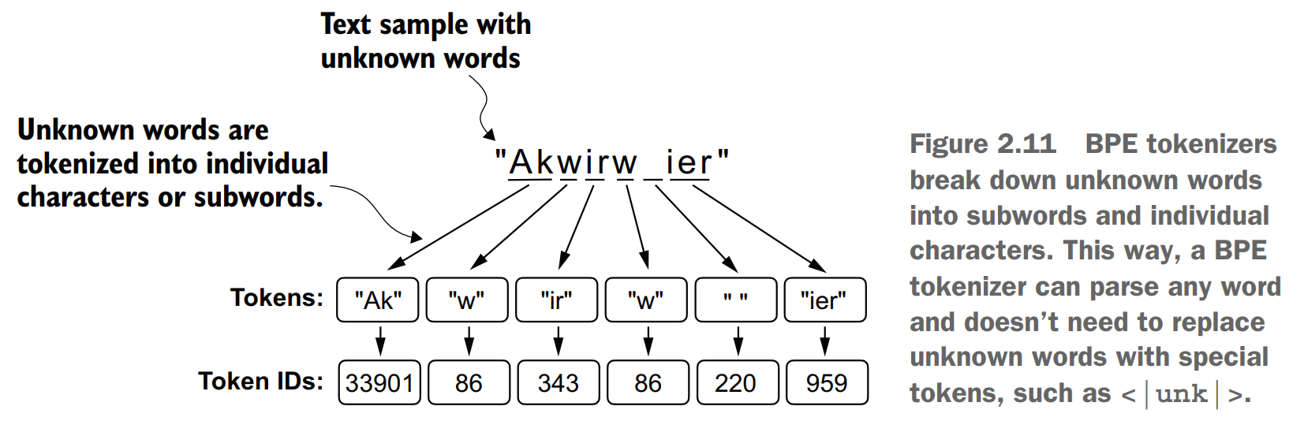
2. Byte Pair Encoding

Slide 17
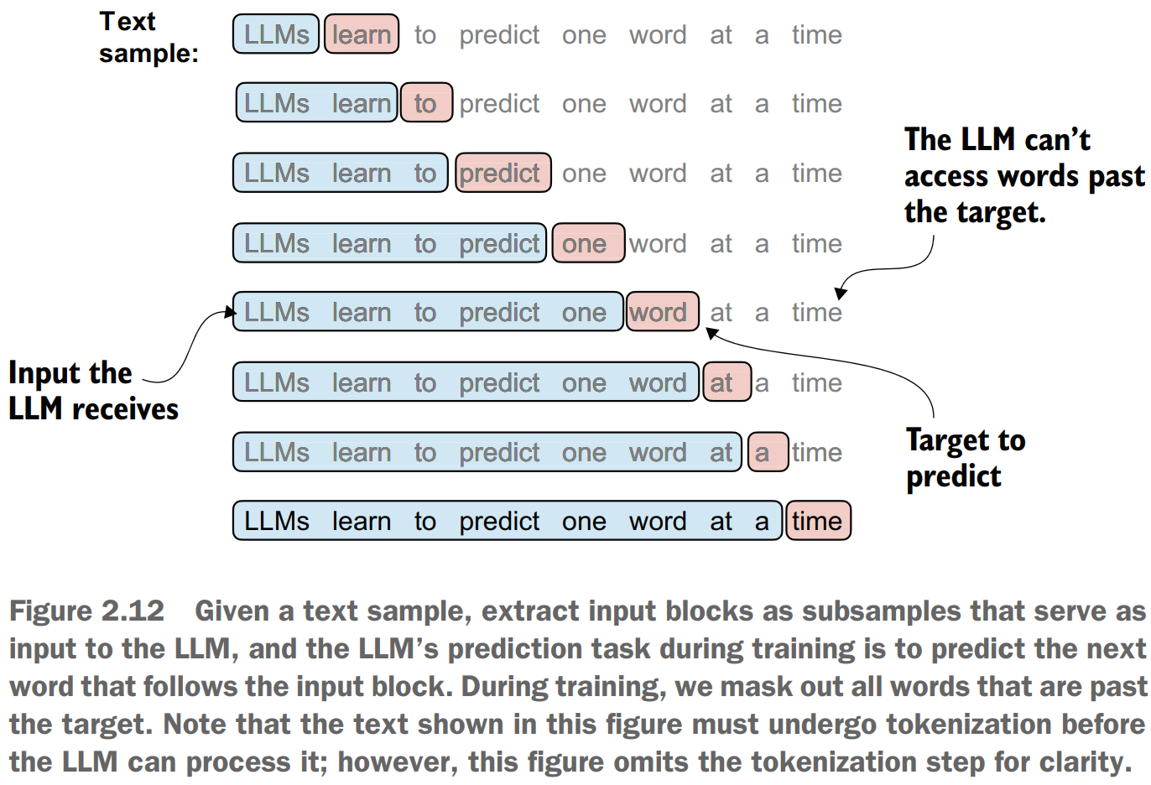
2. Data Sampling with a Sliding Window

Slide 18
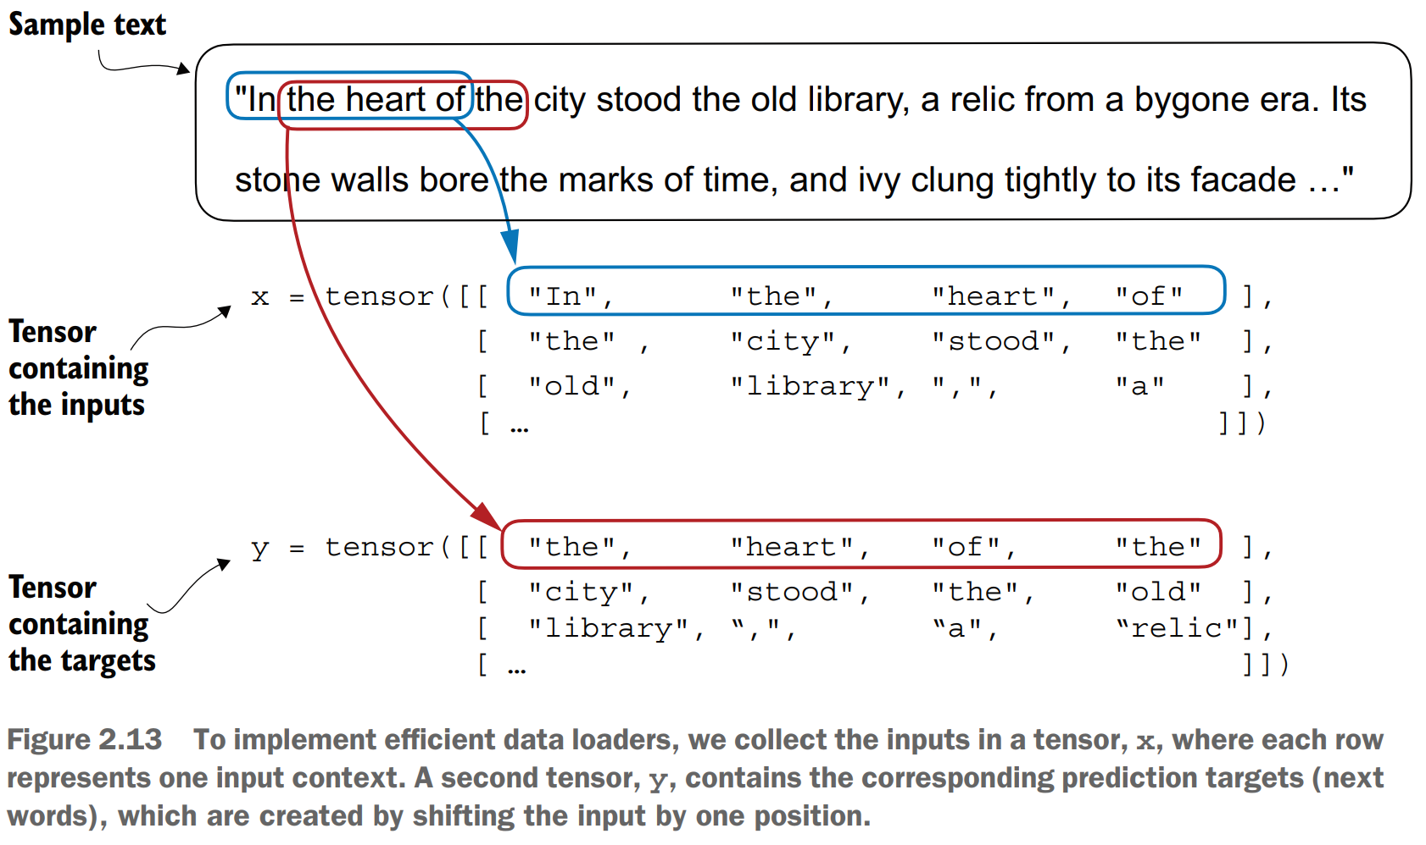
3. Data Sampling with a Sliding Window

Slide 19
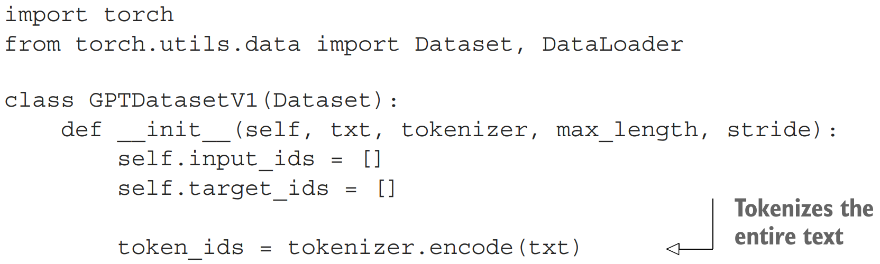
1. Dataset Class for Batched Inputs and Targets

Slide 20
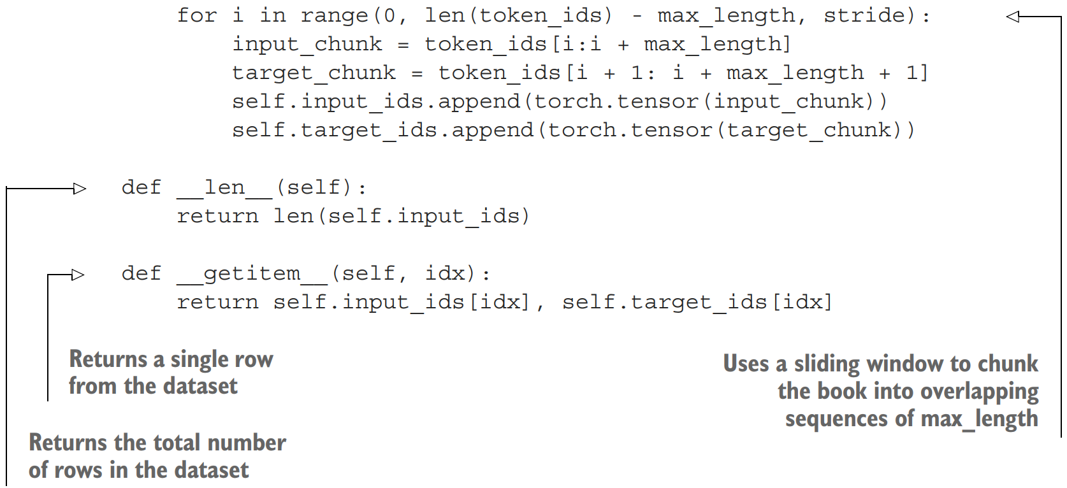
2. Dataset Class for Batched Inputs and Targets

Slide 21
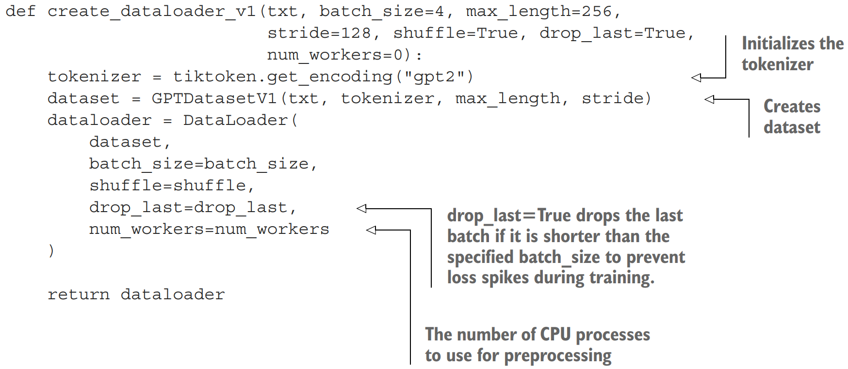
Dataloader Function

Slide 22
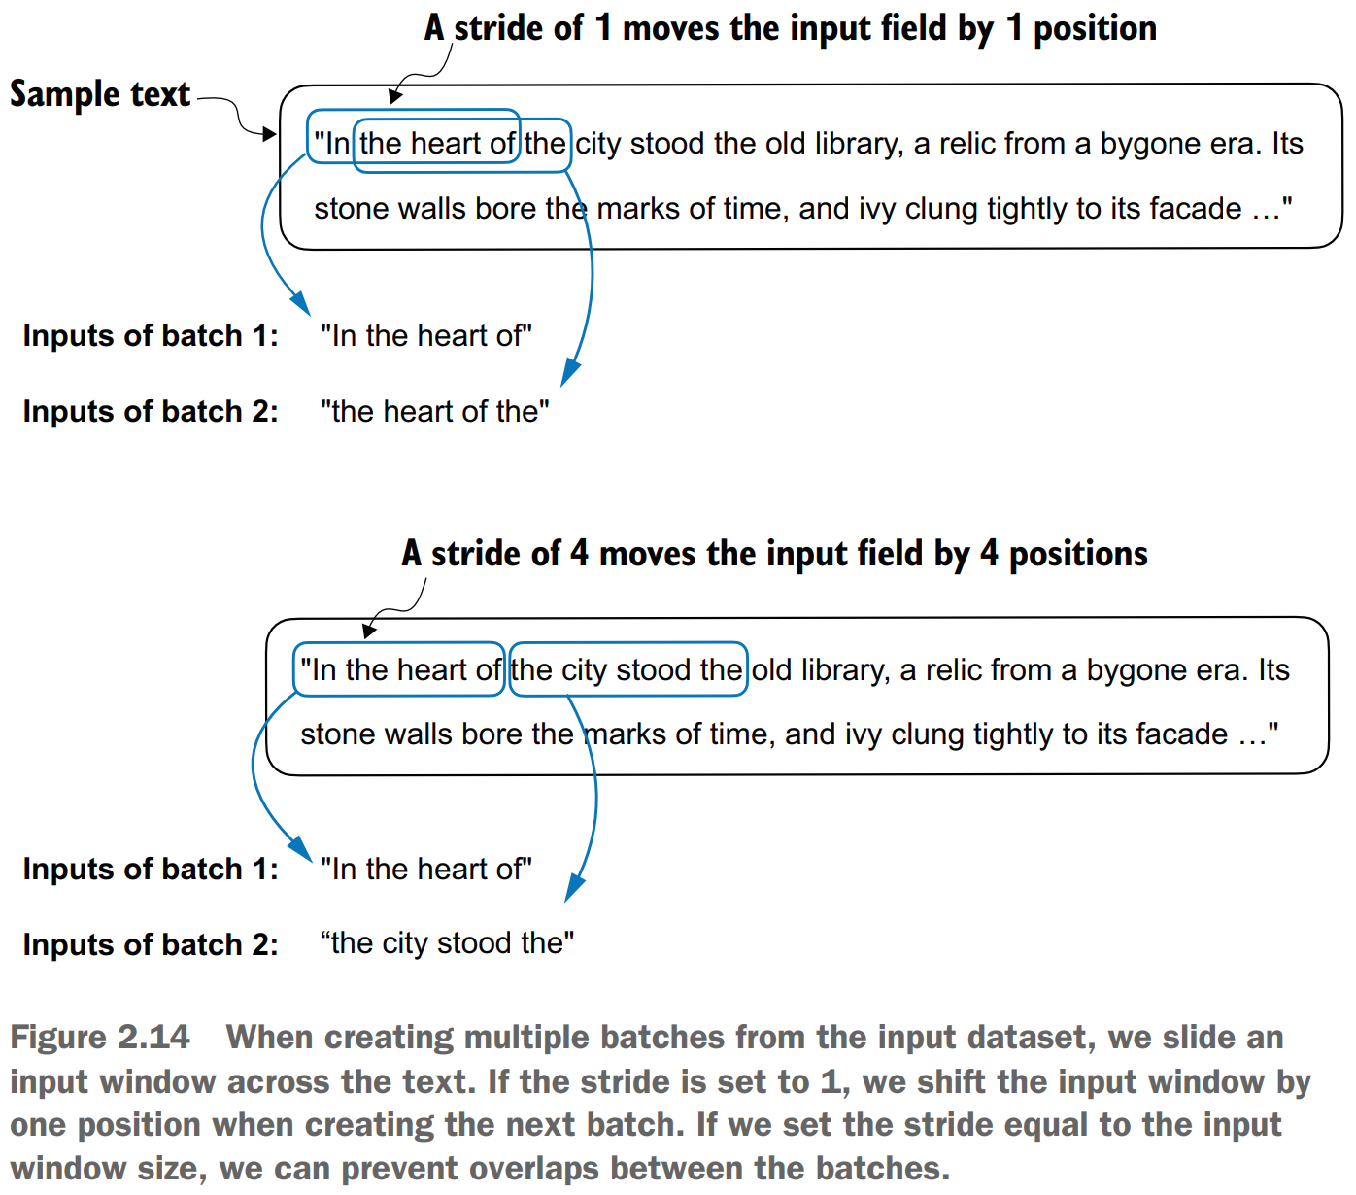
Dataloaders with Different Strides and Context Sizes

Slide 23
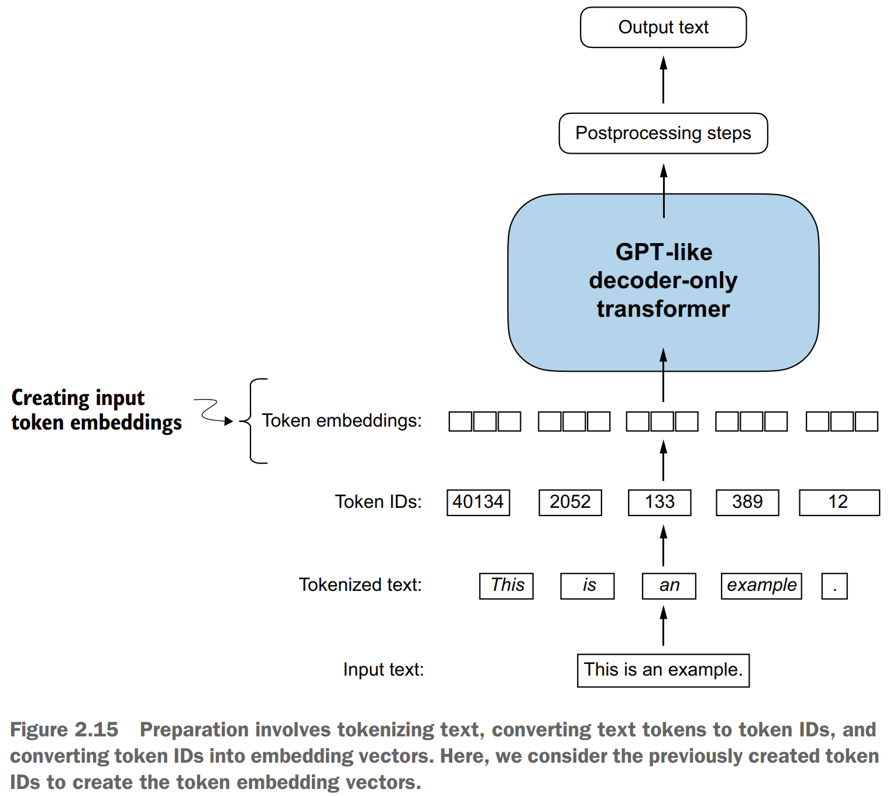
Creating Token Embeddings

Slide 24
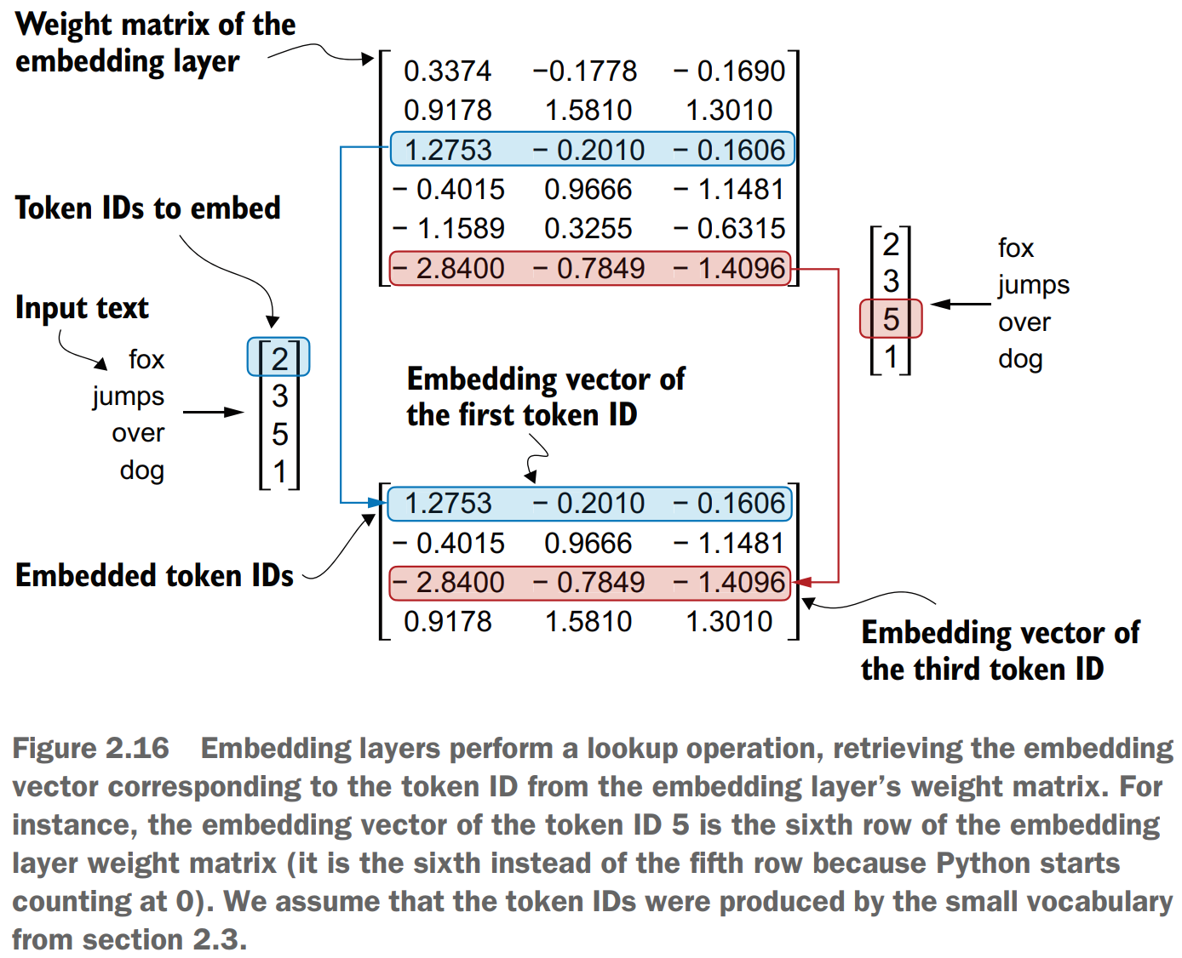
1. Encoding Word Positions

Slide 25
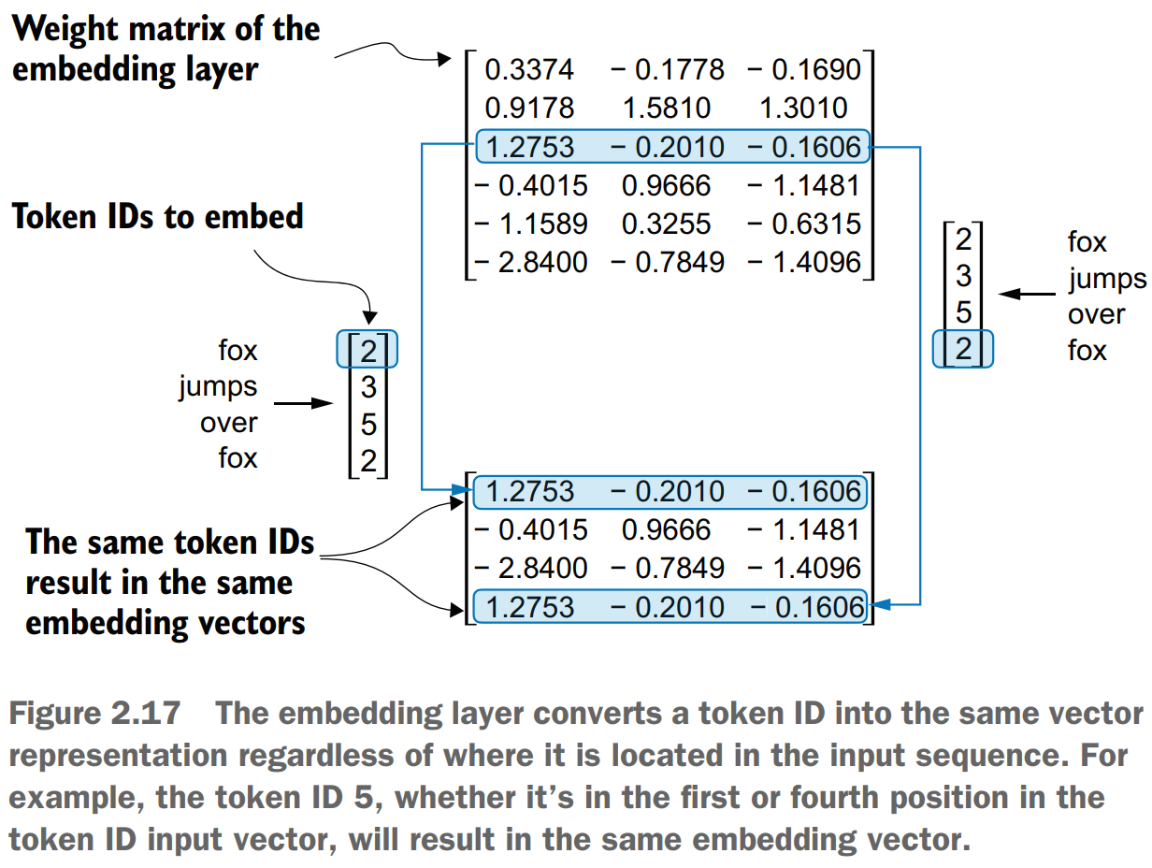
2. Encoding Word Positions

Slide 26
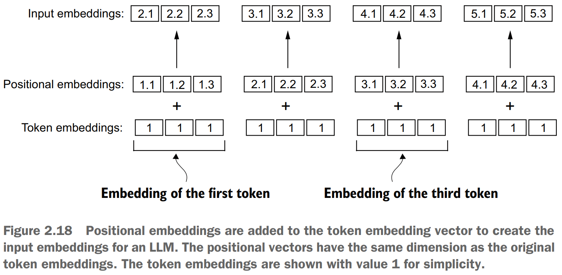
3. Encoding Word Positions

Slide 27
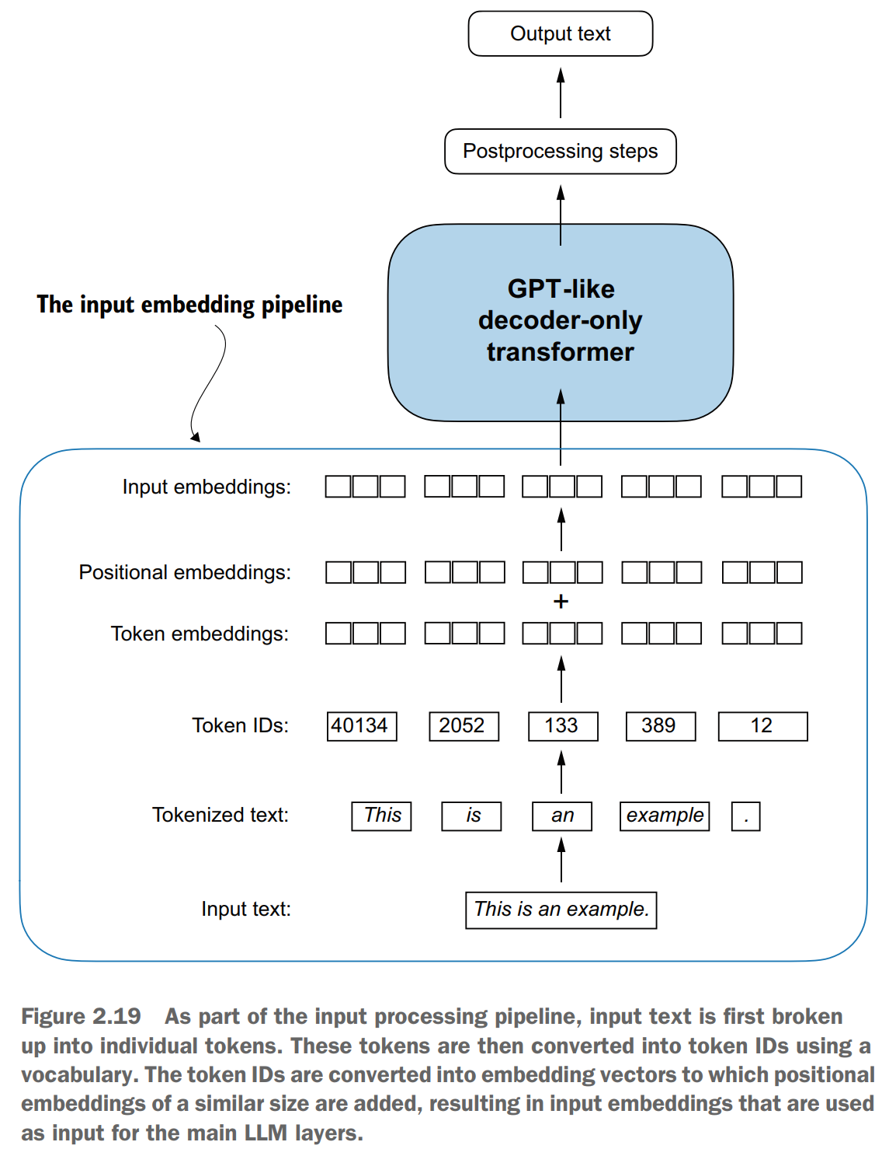
Input Embedding Pipeline

